Slide 1
Business Strategy
Section-1
Unit-1
Business Strategy

Slide 2
What is strategy ?
Strategy -> Greek word-> Strategia
Strategia -> Generalship
Originally was used in military and later on it was introduced to the business world.
Strategy helps to achieve synergy and balance between objectives, resources and concepts to maximize the possibility of success and fruitful results.
The purpose of formulating strategy is to bring consistency and alignment in the activities of an organization, which can be accomplished by various endeavors, methods and resources.

Slide 3
Definitions of strategy:-
According to chandler:-
The determination of the basic, long-term goals and objectives of an enterprise, and the adoption of courses of action and the allocation of resources necessary for those goals.
According to porter:-
Strategy is about being different. It means deliberately choosing a different set of activities to deliver a unique mix of value.

Slide 4
Nature of the strategy:-
Provides structure
Set of action
Future oriented
Combination of internal and external factors
Integrated approach
System oriented

Slide 5
Difference between strategy and tactics
Tactics:-
Greek word-> taktike which means-> art of arrangement
In simple words skill of dealing or handling difficult situations.
Strategy:-
The strategy is a combination of corporate moves and actions used by the management to attain a competitive market position.

Slide 6
 | Tactics | Strategy
Concept | How the strategy to be executed | An planned and organized set of activities
Nature | Preventive | Competitive
What it is ? | Action | Action plan
Focus on | Task | Purpose
Formulated at | Middle level | Top level
Approach | Reactive | Proactive
Orientation | Towards the present conditions | Future oriented

Slide 7
Introduction to business strategy:-
Business worldwide sell goods and services in competitive markets that require them to increase the value for owners and shareholders to secure their future.
Every decision irrespective of their nature in business is equally important in business. This calls for a plan that helps manager guide their decisions and use resource.
The success of any business is determined by the effectiveness of the strategy it follows.
A strategy explains how a company plans to compete in a market and how it intends to grow.

Slide 8
What is Business Strategy ?
A business strategy outlines the plan of action to achieve the vision and set objectives of an organization and guides the decision-making processes to improve the company’s financial stability in an competitive market.
A business strategy refers to all the decisions taken, and actions undertaken by a business for achieving the larger vision.

Slide 9
Importance of business strategy:-
Establishing directions:-
A business strategy will first and foremost set the direction for your company. With a clear direction your business will have something clear to work towards.
Strategies made would be like a stepping stones for any organization where they are pretty much sure about their do’s and don’ts.

Slide 10
Making wise decisions:-
Without direction and sense of purpose, it is difficult to assess the merit of certain decisions. Investing in a new asset may make clear sense with a goal to expand distribution, but may not seems like a wise choice otherwise. A business strategy will give you a clear vision that will help you to determine between good and bad decisions.

Slide 11
Avoid competitive convergence:-
Companies without a business strategy will often look at their competitors for best practice and this can lead to competitive convergence. With competitive convergence it can become impossible to determine between the companies and the market can become diluted.
With a business strategy however you can implement a unique plan that will make you stand out from the crowd instead of just following the trends.

Slide 12
Measure Success:-
Without a business strategy, it can be difficult to measure success because you won’t know what you are trying to achieve. A business strategy will set targets that will allow you to measure your success by comparing yourself to them. This can help you to keep focused on success and ensure that you are constantly progressing.
Increase satisfaction:-
One of the most common reason of leaving any job is the lack of job satisfaction. By having a clear strategy for your business that has set some standards will motivate employee to achieve it and that will give them feel of contribution of their efforts to organization.

Slide 13
Introduction to strategic management:-
Strategic management can also be defined as a bundle of decisions and acts which a manager undertakes and which decides the result of the firm’s performance.
Strategic management is nothing but planning for both predictable as well as unfeasible contingencies. It helps us to identify the direction in which an organization is moving.
Strategic management gives a broader perspective to the employees of an organization and they can better understand how their job fits into the entire organizational plan and how it is correlated to the other organizational members.
One of the major role of strategic management is to incorporate various functional areas of the organization completely as well as to ensure these functional areas harmonize and get together well.

Slide 14
Definition of Strategic Management:-
Strategic management can be defined as the art and science of formulating, implementing, and evaluating cross-functional decisions that enable an organization to achieve its objectives.
According to Ansoff:-
Strategic management is a systematic approach to a major and increasingly important responsibility of general management to position and relate the firm to its environment in a way that will ensureits continued success and make it secure from surprises.

Slide 15
Strategic management process:-
Strategic intent:-
Vision
Mission
Objectives
Strategy formulation:-
SWOT Analysis
Corporate level strategy
Business level strategy
Strategic plan

Slide 16
Strategy implementation:-
Project
Procedural
Resource allocation
Structural
Behavioral
Strategic evaluation:-
Analysis and assessment

Slide 17
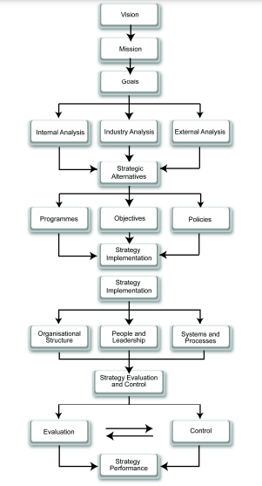

Slide 18
Importance of strategic management:-
Gives competitive advantage
Helps achieve goals
Improves organizational performance
Synchronizes processes, workforce and strategies
Allows using past strategies as a reference for future decisions

Slide 19
Benefits of strategic management:-
Financial benefits :-
Profitability management
Solvency planning
Liquidity monitoring
Improved revenue generation
Prevents legal risks

Slide 20
Non-financial benefits:-
Revitalize human resources identify problems
Better decision making
Improved understanding of competitor strategies
Higher stability

Slide 21
What is strategic decision ?
Strategic decisions is the decisions that look after the environment in which the operation of a firm takes place, the total resources, and the people who developed the company. These decisions have a good impact over years and decades, and even after the lifetime of a project.

Slide 22
Characteristics of strategic decision:-
Activities match the environment
The scope of activity of an organization is a concern
Activities match with the capability of the resources
Decisions like operations are affected.
A company’s long term direction is also affected.

Slide 23
Strategic decision making process:
Define the problem:-
What is the problem? Can it be solved? Is this the real problem or a symptom of a larger one?
What is my objective? What‘s to be accomplished by the decision?

Slide 24
Gather information:-
Talk to individuals or groups affected by the problem
Facts and data: research, benchmarking studies, interviews with credible sources, observed events
Constraints: Lack of funding, resources, cultural barriers
Ask: What am I not seeing? What have I missed?

Slide 25
Develop and evaluate options:-
Choose options that show promise, need more information, can be combined or eliminated, or will be challenged.
Weigh advantages/disadvantages of each. Consider cost to the business, potential loss of morale/teamwork, time to implement the change, whether it meets standards, and how practical the solution is.
Predict the consequences of each option. (“If/Then” or “What if?”)
Ask: What is the worst solution?

Slide 26
Choose the best actions:-
Consider factual data, your intuition, and your emotional intelligence when deciding a course of action.
Accept that the solution may be less than perfect.
Consider the middle ground. Compromising on competing solutions may yield the best decision.

Slide 27
Implement and monitor the decision:-
Step-by-step process or actions for solving the problem
Communications strategy for notifying stakeholders
Resource identification/allocation
Timeline for implementation
Measurements/benchmarks to gauge progress

Slide 28
Strategic decision making models:-
I/O
Model
Resource
Based
Model

Slide 29
Some important terms:-
COMPETITIVE ADVANTAGE - when a firm implements a strategy that creates superior value for customers; competitors are unable to duplicate it or find too costly to imitate it.
RISK - an investor’s uncertainty about the economic gains or losses that will result from a particular investment.
ABOVE-AVERAGE RETURNS - returns in excess of what an investor expects to earn from other investments with a similar amount of risk.
AVERAGE RETURNS - returns equal to those an investor expects to earn from other investments with a similar amount of risk.

Slide 30
I/O MODEL Industrial Organization Model

Slide 31
Four Assumptions of this model:-
The external environment is assumed to impose pressures and constraints that determine the strategies that would result in above-average returns.
Most firms competing within an industry or within a segment of that industry are assumed to control similar strategically relevant resources and to pursue similar strategies in light of those resources.

Slide 32
Resources used to implement strategies are assumed to be highly mobile across firms, so any resource differences that might develop between firms will be short-lived.
Organizational decision-makers are assumed to be rational and committed to acting in the firm’s best interests, as shown by their profit-maximizing behavior.

Slide 34
How would you find an attractive industry ? OR How you would analyse a industry ?
Answer to this question is :-
Porter’s Five Force Model

Slide 35
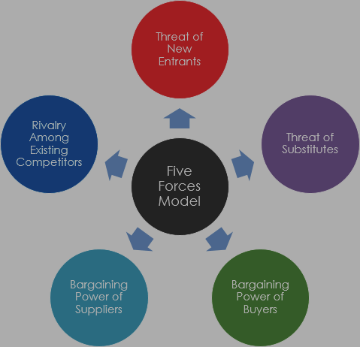

Slide 36
Introduction:-
Presented By:- Michael E. Porter
Year:- 1979
Published in:- Harvard Business Review
Porter’s five forces framework is a method of analysing the operating environment of a competition of a business.
It draws from industrial organization economics to derive five forces that determine the competitive intensity and therefore the attractiveness of an industry in terms of its profitability.

Slide 37
1. Rivalry among the industry:-
This factor considers the number of competitors in the market and how strong they are. Competition is high when an industry has many companies of similar size and power.
Number of competitors
Variety of competitors
Difference in products
Differences in quality
Industry growth
Barriers to exit the industry
Customer loyalty to existing brands

Slide 38
2. Threat of new entrant:-
This factor considers how easily competitors can enter the market. As more companies join an industry, existing businesses risk losing some of their customers and profits.
Government regulations
Customer loyalty to existing brands
High costs of entry
Limited access to distribution
Technologies needed
Experience needed
Economies of scale

Slide 39
3. Threat of substitute product:-
This factor considers how easily customers can switch between similar products or services. If a product or service is so easy to make that many substitute products exist, companies also risk customers doing it themselves.
No. of substitute products
Quality and price of substitute products
Customer’s likelihood to switch between products
Customers perceived difference between products
Competitor’s aggressiveness
Competition’s profit

Slide 40
4. Bargaining power of buyers:-
Buyers have greater bargaining power when their numbers are small but the amount of substitute products is high. As a result, they can cause prices to lower and company profit.
No. of customers
How much product each customer is buying ?
Buyer’s ability to substitute products
Buyers sensitivity to price
Buyer’s access to information so they can compare products and prices

Slide 41
5. Bargaining power of suppliers:-
The more suppliers a company has to choose from, the easier it is to switch to one that costs less or produces a higher quality products. If few suppliers offer the products a company needs they have more power.
No. of suppliers
Size of the suppliers
Uniqueness of the suppliers product
Quality of supplier products
Volume of product needed
Cost of switching suppliers

Slide 42
Resource Based Model

Slide 43
