Slide 1
Chapter 7 :- Quality Planning.

Slide 2
Quality Control
Quality control is a set of methods used by organizations to achieve quality parameters or quality goals and continually improve the organization's ability to ensure that a software product will meet quality goals.

Slide 3
Quality Control Process:

Slide 4
Software Quality Assurance
Software Quality Assurance (SQA) is a set of activities for ensuring quality in software engineering processes.
It ensures that developed software meets and complies with the defined or standardized quality specifications.
SQA is an ongoing process within the Software Development Life Cycle (SDLC) that routinely checks the developed software to ensure it meets the desired quality measures.

Slide 5
It includes the following activities:
Process definition and implementation
Auditing
Training

Slide 6
Software review techniques.
A review is a systematic examination of a document by one or more people with the main aim of finding and removing errors early in the software development life cycle.
Techinique – Defect amplification & removal.

Slide 9
Formal technique review:
A formal technical review is a software quality assurance activity performed by software engineers (and others).
The objectives of the FTR are
(1) to uncover errors in function, logic, or implementation for any representation of the software.
(2) to verify that the software under review meets its requirements.
(3) to ensure that the software has been represented according to predefined standards.

Slide 10
(4) to achieve software that is developed in a uniform manner.
(5) to make projects more manageable.
The Review Meeting
Regardless of the FTR format that is chosen, every review meeting should stand for by the following constraints:
Between three and five people (typically) should be involved in the review.
Advance preparation should occur but should require no more than two hours of work for each person.
The duration of the review meeting should be less than two hours.

Slide 11
At the end of the review, all attendees of the FTR must decide whether to
(1) accept the product without modification,
(2) reject the product due to severe errors (once corrected, another review must be performed), or
(3) accept the product provisionally (minor errors have been encountered and must be corrected, but no additional review will be required).

Slide 12
Quality planning
quality plan describes how an organisation will achieve its quality objectives.
It describes the quality objectives and specifies the quality assurance and control activities to be performed in day-to-day company operations.
In the case of a software development organization individual quality plans may be prepared for each software or systems engineering project.

Slide 13
An organizational quality plan is typically prepared by the Quality Manager and covers the following issues:
Quality management system scope
Quality objectives and goals
Resource requirements
Schedule
Risk analysis

Slide 14
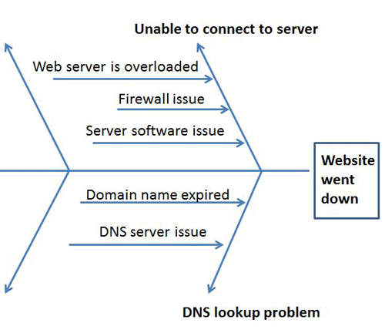
Fish bone diagram
A fishbone diagram is useful in brainstorming sessions to focus conversation.

